Slide 1




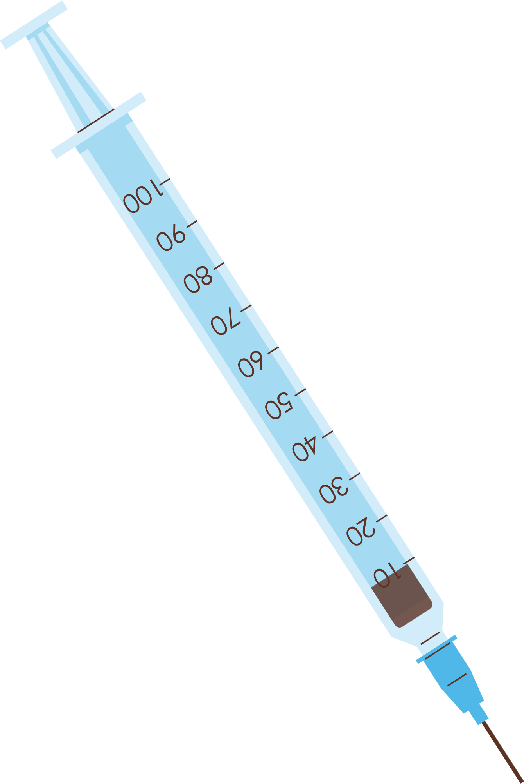



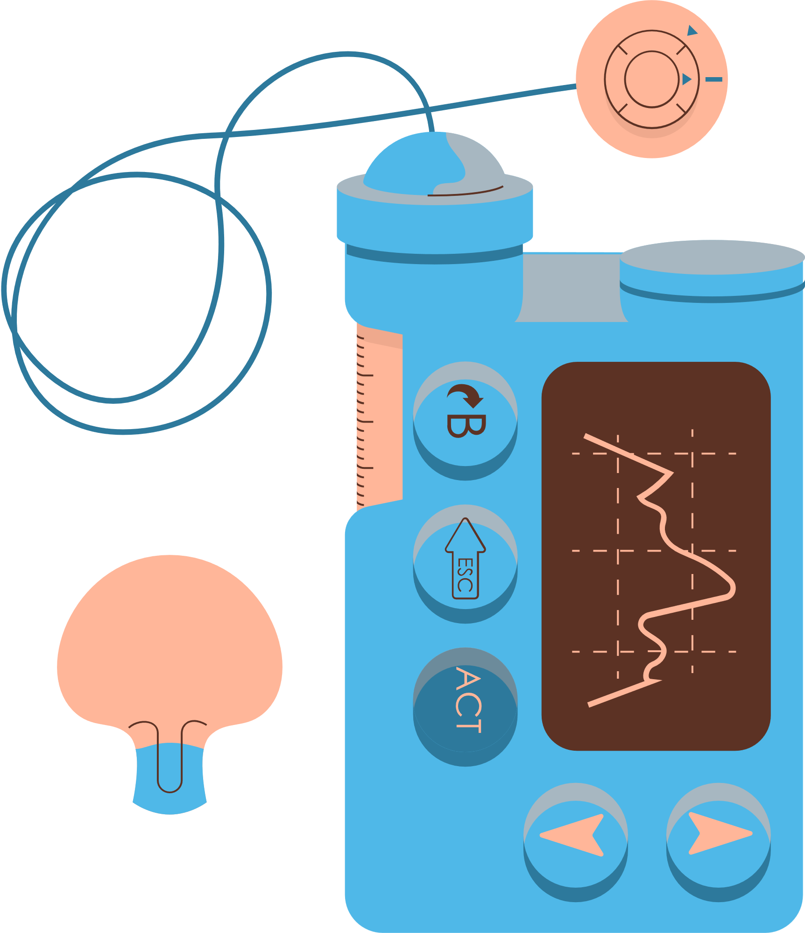
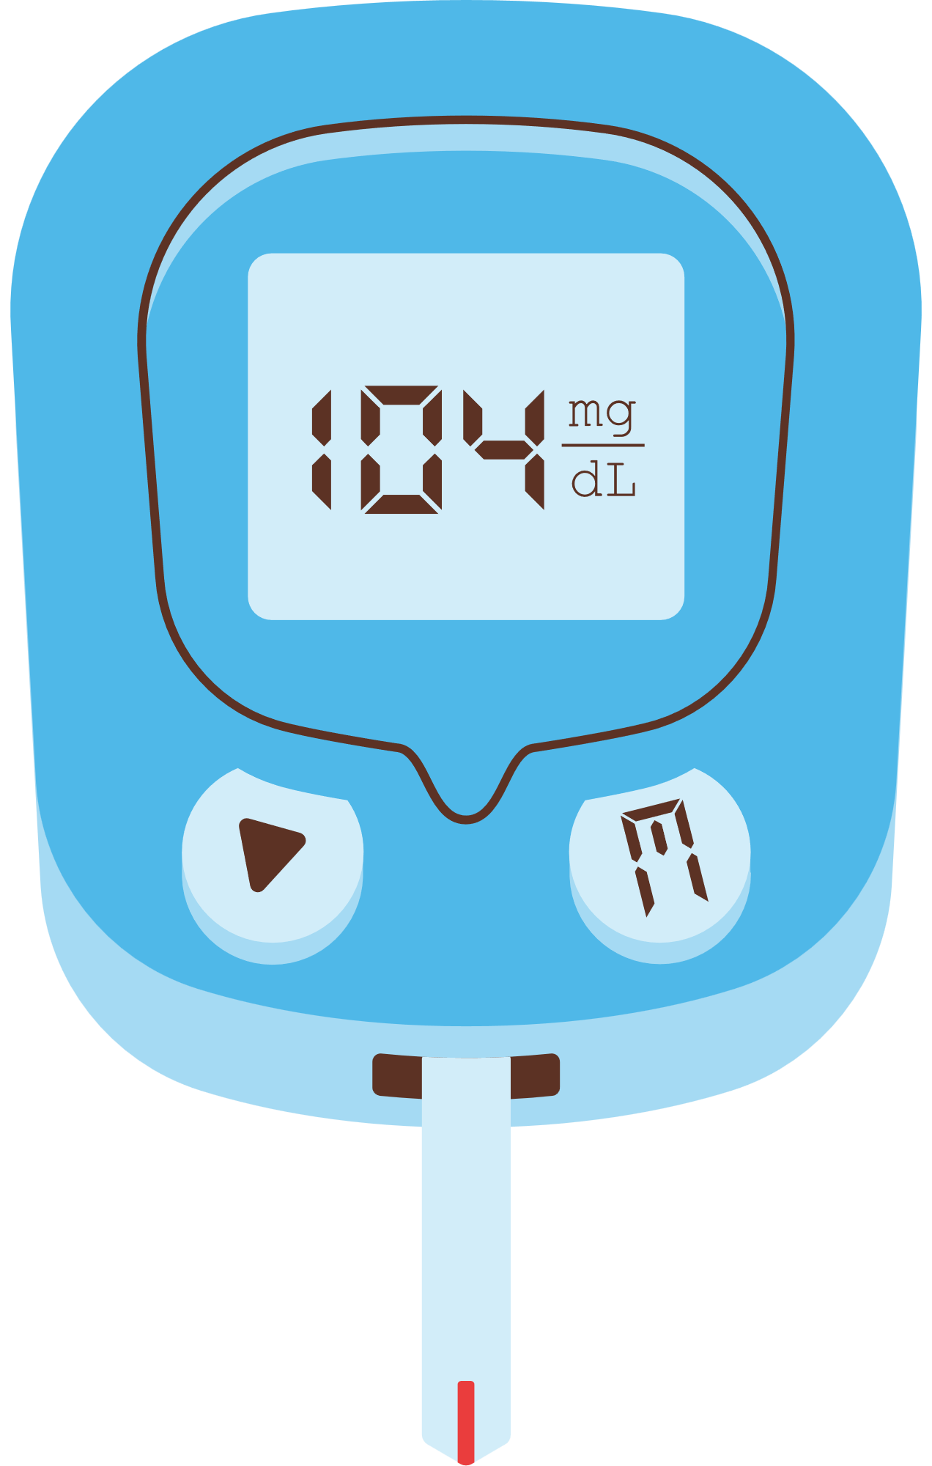

DIABETES
PROGNOSIS
Precision Forecasting for Improved Patient Outcomes

Slide 2

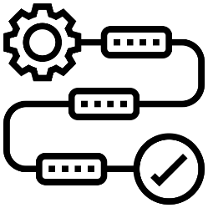







Feature Extraction
Methodology
Divide Features into X and Y
Algorithms or Models Used
Machine Learning / Deep learning
Compare each Evaluate Algorithm
Data Gathering /Data Refinement
Experimental Results
Comprehensive Dataset Overview
STEP 04
STEP 05
Visuals of Compared models
Refinement and Data Preparation Steps
Accuracy, confusion matrix of models
STEP 03
STEP 06
Literature Review
Conclusion
Existence papers and Classifications
STEP 02
STEP 07
Importance of the used approach
Discussion of Approaches / Algorithm to Identify
Suggestion for future
TABLE OF CONTENTS
Appendices and References
Introduction
STEP 01
STEP 08
Reason / Issues causing Diabetes
Links and codes used in the project
Objectives and Value of the study

Slide 3


INTRODUCTION
A chronic metabolic disorder characterized by high levels of sugar (glucose) in the blood
Diabetes encompasses,
Type 1 characterized by autoimmune insulin deficiency
Type 2 with insulin resistance, gestational during pregnancy, and rare forms.
Early prediction through Machine learning enables early detection of diabetes by analyzing diverse data sets to identify patterns indicative of pre-diabetic or diabetic conditions.

Slide 4







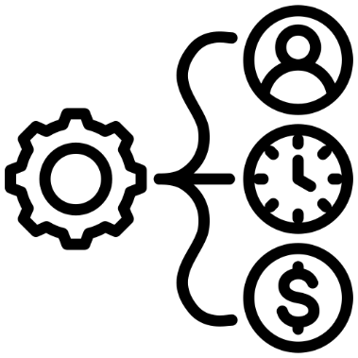
VALUE OF THE STUDY
VALUE OF THE STUDY
RISK STRATIFICATION
EARLY DETECTION AND PREVENTION
RESEARCH AND DEVELOPMENT
REAL-TIME MONITORING
OBJECTIVE OF THE STUDY
OBJECTIVE OF THE STUDY
`
COMPARING ALGORITHMS
RESOURCE ALLOCATION
REDUCED HEALTHCARE COSTS
PUBLIC HEALTH ADVANCEMENT

Slide 5




ARTICLE
Review Of Literature
Diabetes Prediction Using Machine Learning Algorithms
This paper proposes a Diabetes prediction model that integrates additional external factors along with traditional indicators to enhance classification accuracy
Aishwarya Mujumdar , Dr. Vaidehi V
27 February 2020
This paper focuses on data preprocessing including handling missing values and normalization, to ensure the accuracy of the predictive model
Accuracy with PIMA Dataset
Logistic Regression
Accuracy Diabetes Dataset
76%
96%
Linear Discriminant Analysis
It utilizes various machine learning algorithms such as Support Vector Classifier, Random Forest Classifier, and Logistic Regression to predict diabetes based on the processed dataset
77%
94%
Gradient Boost Classifier
77%
93%

Slide 6


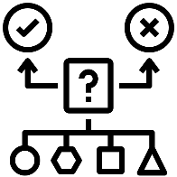



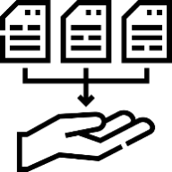
STEP 07
WORK FLOW
WORK FLOW
MONITOR AND UPDATE
Continuously monitor the model's performance in the real-world scenario
STEP 06
MODEL EVALUATION
Assessing the performance of a machine learning model using metrics
STEP 05
MODEL SELECTION AND MODEL TRAINING
Choosing a suitable machine learning algorithm and optimizing its parameters
STEP 04
SPLIT TRAIN AND TEST DATA
Dividing the dataset into training and testing sets to evaluate
STEP 03
PREPROCESSING
Preparing and cleaning data to enhance its quality and suitability
EXPLORATORY DATA ANALYSIS
STEP 02
Analyzing and visualizing data patterns to understand its characteristics
STEP 01
DATA COLLECTION
Gathering and organizing data to train machine learning models.

Slide 7


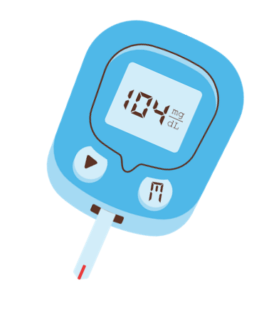



DATA COLLECTION & REFINEMENT
268
DIABETES DATASET - PIMA INDIANS
ROWS :
COLUMNS :
768
9
0
768
AGE
NO. OF DIABETES PATIENTS
Demographic Information
BMI
X
Glucose
Blood Pressure
Insulin
Clinical Data
Pregnancies
Skin Thickness
Diabetes Pedigree Function
Missing Value
Y
Outcome Variable
0 - Normal
None
Outcome
1 - Diabetic
Duplicate Values
None
Machine learning facilitates the early detection of diabetes by analyzing vast amounts of patient data, enabling personalized risk assessments and timely interventions to prevent complications. Its predictive capabilities aid in identifying high-risk individuals, allowing for targeted interventions and improved management strategies
Outliers
Present

Slide 8
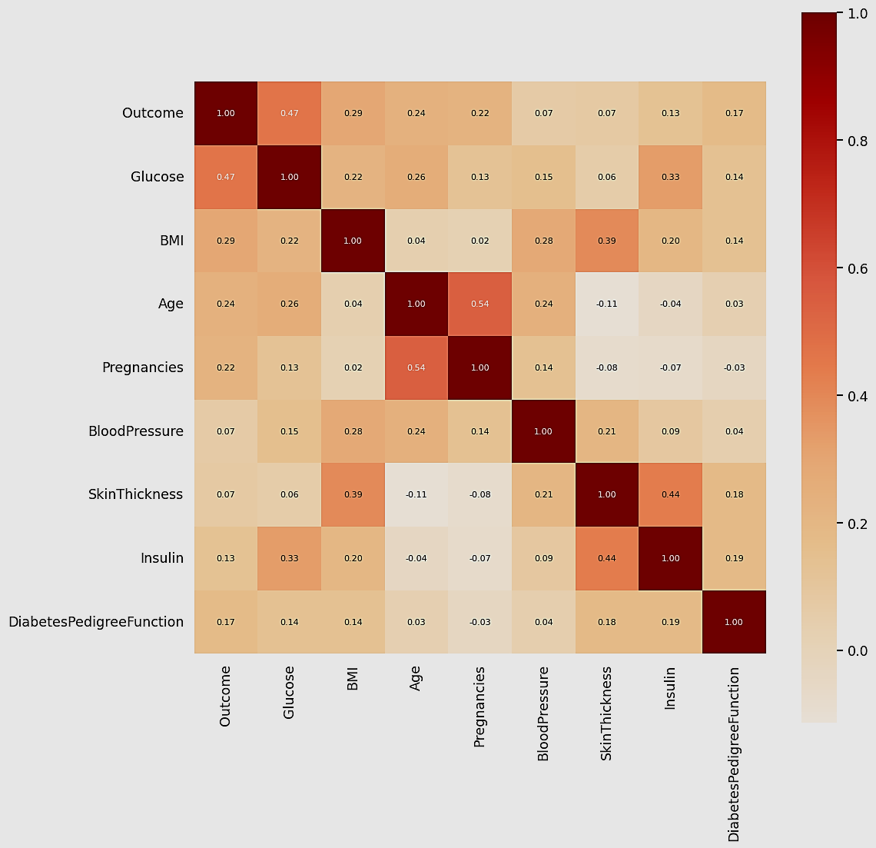
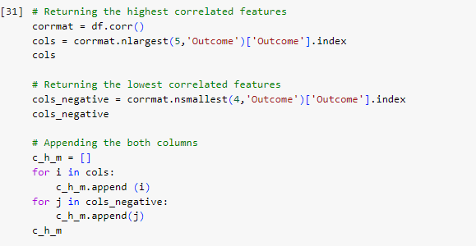
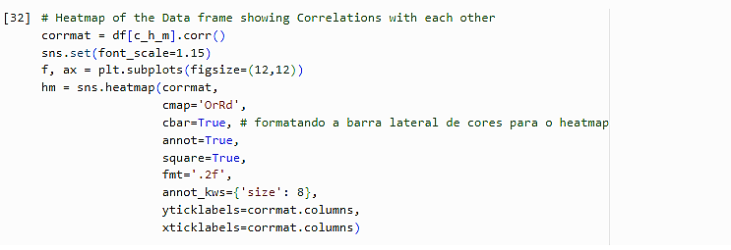
HEATMAP OF THE DATA FRAME
These correlations suggest certain relationships within the dataset:
Glucose levels might strongly influence the outcome of whatever scenario or study is being conducted.
The number of pregnancies tends to be correlated with the age of the individuals in the dataset.
Insulin levels seem to be closely related to skin thickness in the dataset.

Slide 9
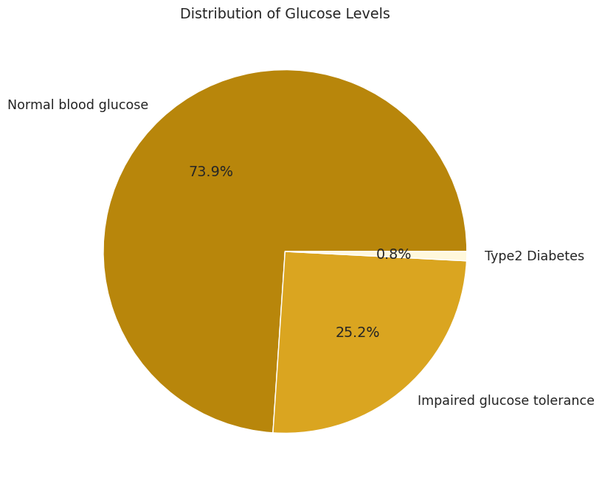
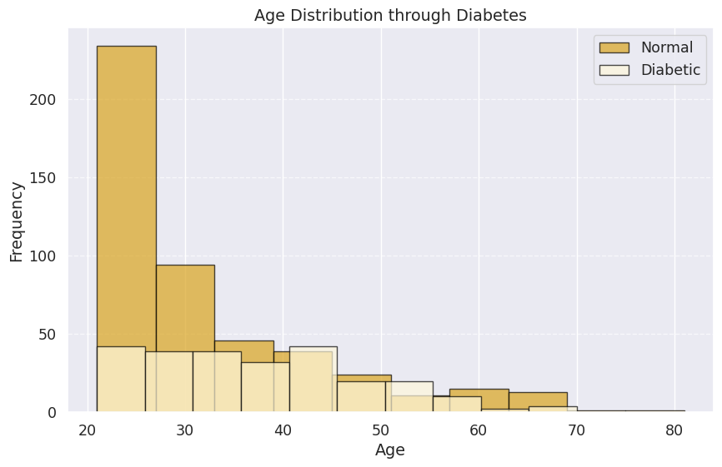
Ages between 40 to 45: Higher incidence or prevalence of diabetes. This indicates that individuals aged between 40 to 45 are more likely to have diabetes compared to other age groups.
Ages after 70 :Diminishing trend in the prevalence or incidence of diabetes. This suggests that as individuals age beyond 70, having diabetes decreases or becomes less prevalent.
AGE DISTRIBUTION AND OUTCOME CORRELATION
GLUCOSE LEVEL SPREAD: A VISUAL OVERVIEW
A significant portion of the patient population demonstrates normal blood glucose levels, indicating that they fall within the healthy range and do not currently have diabetes.
Conversely, instances of impaired glucose tolerance (prediabetes), where blood glucose levels are elevated but not high enough for a diabetes diagnosis, are comparatively less prevalent among the patients under study

Slide 10


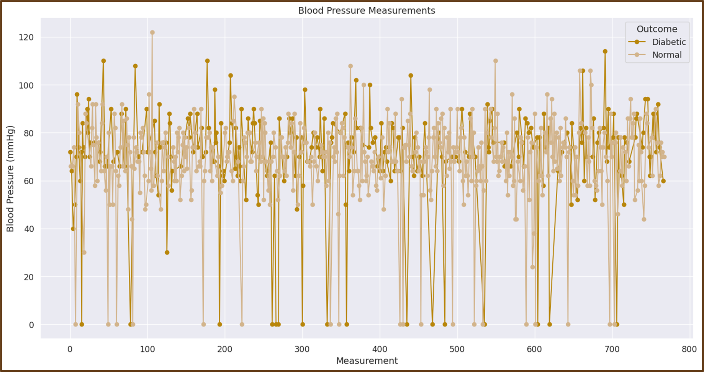
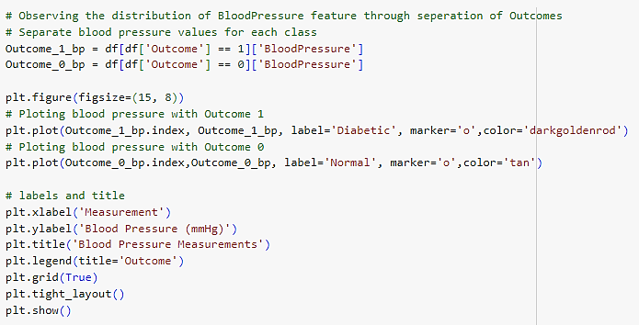
BLOOD PRESSURE DISTRIBUTION AND OUTCOME ANALYSIS
Patients diagnosed with diabetes generally display slightly elevated average blood pressure levels when compared to those without diabetes.
Conversely, individuals without diabetes tend to have slightly lower average blood pressure readings in comparison to those with diabetes.
Quite a few Outliers are visible in both blood pressure reading diabetic as well as normal patients

Slide 11

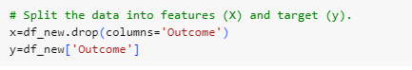



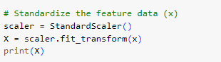
Feature Extraction
Dividing dataset into “ x ” and “ y ”
Dividing dataset into Training Data and Testing Data.
BMI
Skin Thickness
X
Pregnancies
Diabetes Pedigree Function
Glucose
Blood Pressure
Insulin
Standardize the feature data (x)
Y
0 - Normal
Outcome
1 - Diabetic

Slide 12
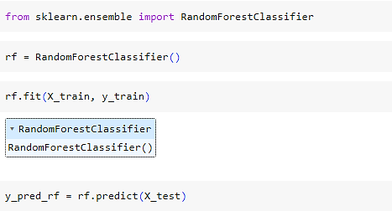
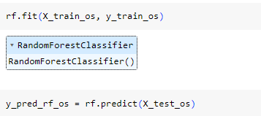
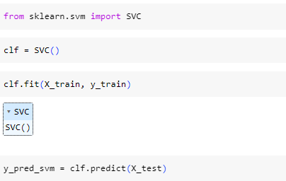
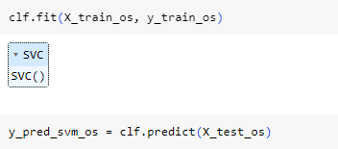
METHODOLOGY
Model
RandomForestClassifier
SMOTE
SMOTE in Random Forest balances class distribution by creating synthetic samples for the minority class, improving model performance on imbalanced datasets.
Random Forest:
- Ensemble of decision trees for robust predictions.
Model
Support Vector Machine (SVM)
SMOTE
SMOTE in Support Vector Machines enhances classification accuracy by generating synthetic samples for the minority class to address class imbalance effectively.`
SVM (Support Vector Machine):
- Effective in high-dimensional spaces, ideal for complex datasets.

Slide 13
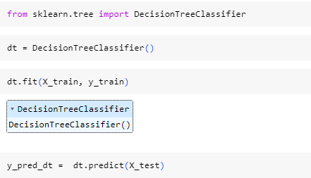
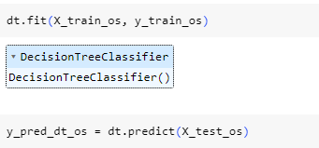
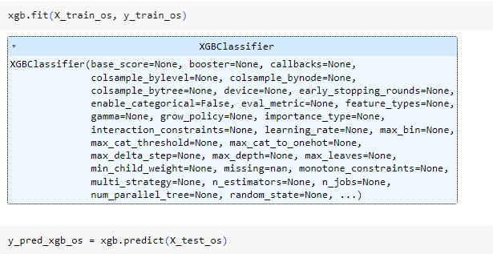
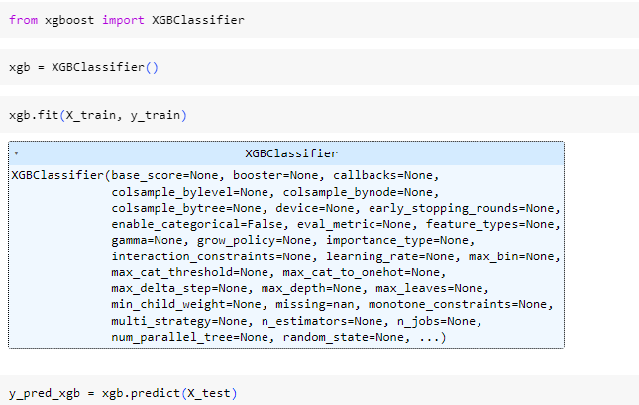
Model
DecisionTreeClassifier
SMOTE
SMOTE in Decision Trees involves creating synthetic instances for the minority class to counter class imbalance, thus enhancing the tree's performance in capturing minority class patterns.
DecisionTreeClassifier:
- Non-linear models that recursively partition the feature space.
Model
Gradient Boosting Classifier (XGBoost))
SMOTE
SMOTE in XGBoost involves synthesizing additional samples for the minority class to address class imbalance, thereby improving the model's ability to accurately predict minority class instances.
XGBoost:
- Gradient boosting algorithm for enhanced accuracy.

Slide 14



ACCURACY
Before SMOTE
After SMOTE
.
Understanding
%
%
Random Forest Classifier | 75.35 | 84.00
Support Vector Machine | 73.38 | 83.00
XG Boost | 75.32 | 81.00
KNN Classification | 76.62 | 80.00
Decision Tree Classifier | 68.1 | 81.50
SMOTE creates synthetic samples: It generates new minority class instances by interpolating between existing ones, effectively balancing class distribution.
Improves classifier performance: By addressing class imbalance, SMOTE enhances the classifier's ability to learn from minority class instances, resulting in improved predictive accuracy and model generalization
.
Experimental Results:
SMOTE effectively mitigated class imbalance issues across multiple classification models, substantially enhancing their predictive performance.
Percentage (%)
After applying Synthetic Minority Over-sampling Technique (SMOTE), the classification models demonstrated significant improvements in accuracy across the board, with the highest increase observed in the Random Forest Classifier, jumping from 75.35% to 84%
The before-and-after comparison underscores the importance of addressing class imbalance through techniques like SMOTE, which can lead to more reliable and robust predictive models across various machine learning algorithms.

Slide 15





CONCLUSION
KEY FINDINGS
SMOTE consistently boosted accuracy across all models, with RandomForestClassifier showing the most significant improvement from 75.35% to 84%
Before SMOTE, class imbalance affected model accuracy, but after applying SMOTE, the class distribution became more balanced, resulting in more accurate predictions across all classifiers.
The accuracies of all algorithms were above 80% with the lowest accuracy of 80% given by KNN Classification and the highest accuracy given RandomForestClassifier as previously mentioned.
LIMITATIONS
Patient Heterogeneity: Diabetes complexity varies among patients, hampering model generalization and reducing accuracy in broader healthcare contexts. Adaptable approaches are crucial to accommodate population diversity for reliable predictions.
Temporal Dynamics: Diabetes progression and risk factors evolve over time, necessitating dynamic modeling to capture temporal patterns effectively. Static models may overlook these changes, limiting their predictive performance in real-world scenarios.
Model Generalization: Diabetes prediction models' limited training data can lead to overfitting, impairing their ability to generalize to new data and accurately capture disease patterns.
FUTURE RESEARCH
Future studies in diabetes prediction could delve into integrating multi-omics data, encompassing genomics, metabolomics, and proteomics, to refine predictive accuracy. This approach offers a comprehensive understanding of the disease's molecular intricacies and individual variations, potentially paving the way for more precise diagnostic and therapeutic strategies

Slide 16

REFERENCES

Aishwarya Mujumdar, V Vaidehi, Diabetes Prediction using Machine Learning Algorithms,
Procedia Computer Science, Volume 165, 2019, Pages 292-299,
ISSN 1877-0509,
https://doi.org/10.1016/j.procs.2020.01.047.

Smith, J.W., Everhart, J.E., Dickson, W.C., Knowler, W.C., & Johannes, R.S. (1988). In Proceedings of the Symposium on Computer Applications and Medical Care (pp. 261--265). IEEE Computer Society Press

Conflicts of Interest
The authors declare no conflict of interest.

Software Involved
Google Colab
Microsoft Excel 2021
Jupiter Notebook
Microsoft PowerPoint 2021

Slide 17

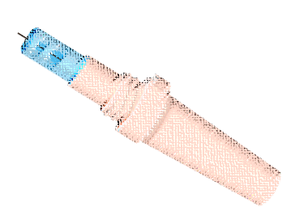

THANK
THANK
YOU
YOU
Diabetes is not a burden, but a lesson in perseverance and self-care.
Diabetes is not a burden, but a lesson in perseverance and self-care.

